Slide 1

LENDING CLUB CASE STUDY
CASE STUDY 1 – EDA – IIIT-B/UPGRAD
Sagar Zanwar
Batch - 1991

Slide 2

Steps Followed
Data Sourcing & Business Understanding
Data Cleaning
Derive Metrics
Univariate Analysis
Bivariate Analysis
Conclusion
Outlier Treatment
Cleaning Rows and Columns
Operation on Missing Values
Standardization
Segmented Univariate Against Target Variable
Single Feature Analysis

Slide 3
Data Sourcing & Business Understanding
Business Understanding:
Data has been sourced from Consumer Finance Company that contains the complete loan data for all loans issued through the time period 2007 to 2011
The company wants to understand the driving factors (or driver variables) behind loan default, i.e. the variables which are strong indicators of default
Initial Observations:
39717 rows: 111 columns, 87 numeric, 24 object
Assumptions:
Data has unique member IDs, hence there are no repeat customers (even if there are there is no way to identify)
Long term loans i.e. '60 month' loans do not include terms extended due to defaults
Revolving utilization rate is not related to current loan; it relates to all credit lines available (Since the definition in data is not clear)

Slide 4
Data Cleaning
Cleaning Rows and Columns
Rows:
Deleted Rows for current loan as they do not provide insight on if the loan will be defaulted
Columns:
Deleted Columns that have only NULL values
Deleted Column that have single value; Since these do not help identify defaulters separately
Deleted No Impact – identifier columns such as ID, URL, title, because these are huge in categories and can not help analyze or predict defaulters
Deleted customer behavior columns: Because these will not be present while you decide if the prospect will default or pay

Slide 5
Data Cleaning
Operate on Missing Values
There are 3 columns that need attention as they have multiple null values and 1 column that has No data value
Revolving Utilization Rate: has few records and such records can be removed directly
Employment Length & Public bankruptcy Record:
Have significant records and need a replacement for null values
Home ownership column has categories, ‘Other’ and ‘No data’
These values are treated as required:
Replaced with Mode for categories, Median for Numeric and removed rows for small number columns

Slide 6
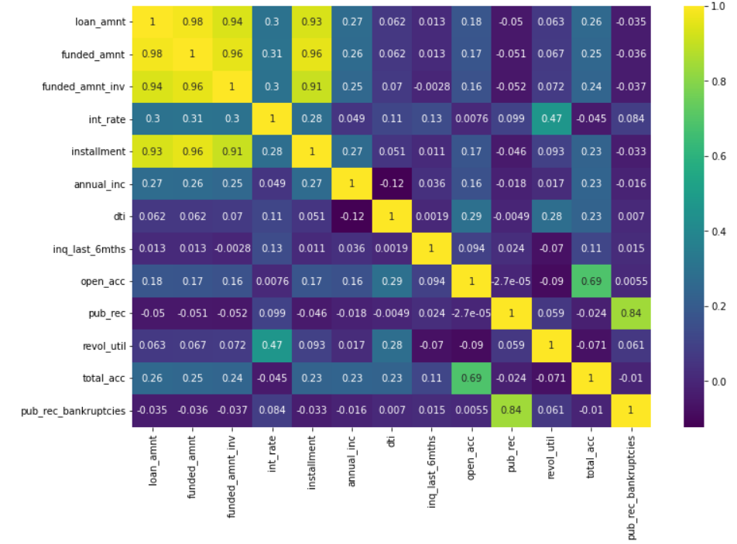
Data Cleaning
Standardization
‘%’ sign removed from numeric columns marked as string type columns and converted to float; Numeric columns marked as object columns have been changed to numeric
Highly correlated values are removed from the analysis
E.g. Loan Amount and Funded Amount are extremely highly correlated; Only one of those is taken forward to avoid skewed results

Slide 7
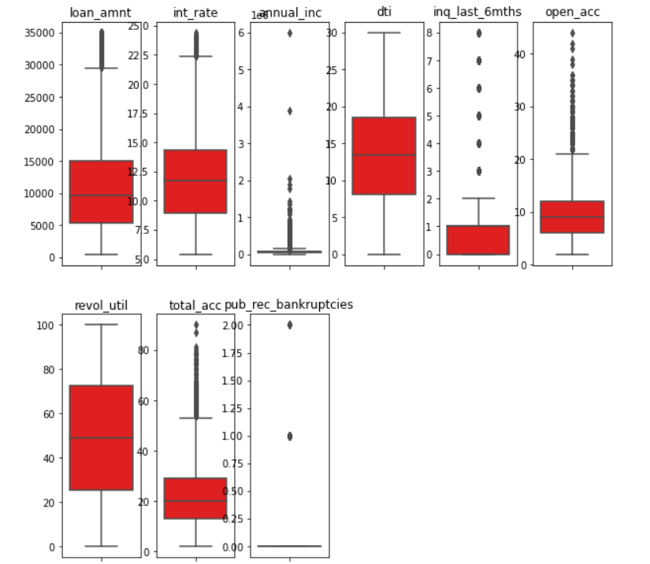
Data Cleaning
Outlier treatment
Outliers found in most of the numeric variables
However, except ‘Annual Income’, all other outliers have acceptable outliers since these have gradual decrease in numbers on bell curve
Outlier from Annual Income are removed for 97.5th percentile and over

Slide 8
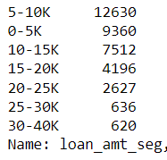
Derived Metrics
New Metrics are derived from categorical variable that have many unique values
E.g. Loan amount ranges from $500 to $35,000
Hence it is categorized into 7 buckets of $5K each

Slide 9
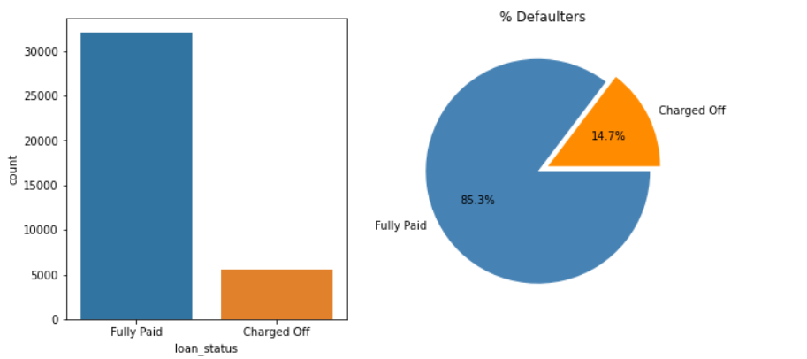
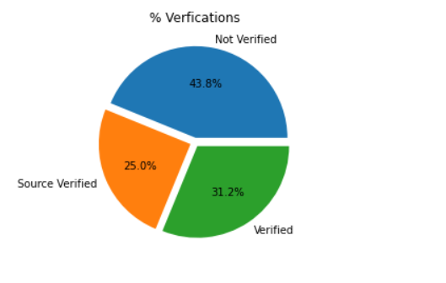
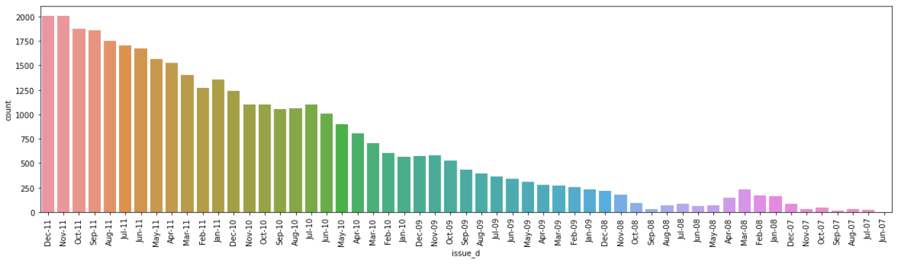
Univariate Analysis
~ 15% of the loans are defaulted;
Total number of loans increased almost each month since 2007
~ 44% of approved loans are not verified

Slide 10
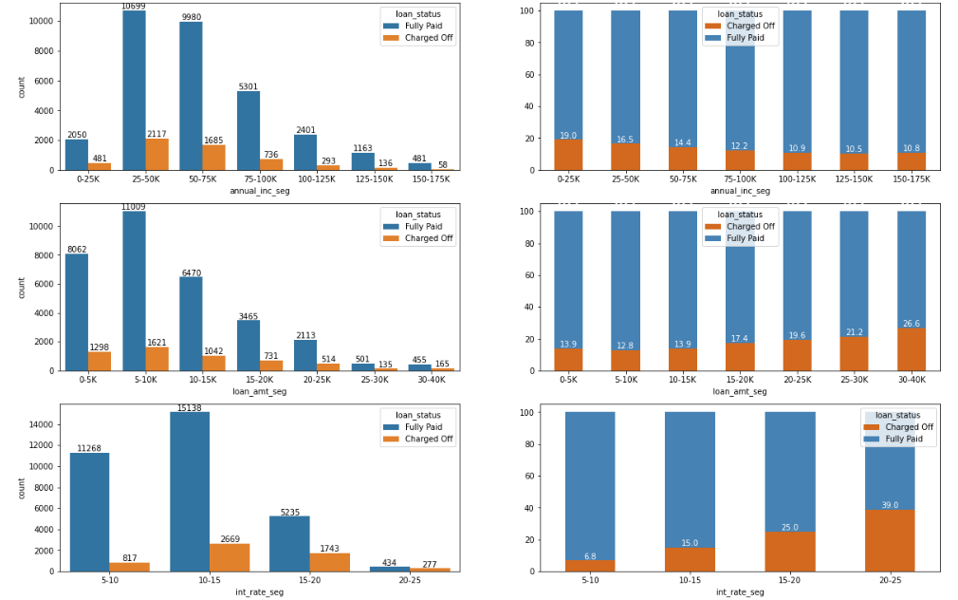
Univariate Analysis
Segmented Univariate Analysis – By Customer and Loan Features
Segmented Univariate Analysis is done on 13 different categories to look at their impact on target variable i.e. Loan Status
Of 13 combinations of charts in Jupyter notebook,
First Chart denotes the number of loans by categories and segments
Second denotes % Share of the same
The bad value loans can be identified as any % defaulters

Slide 11
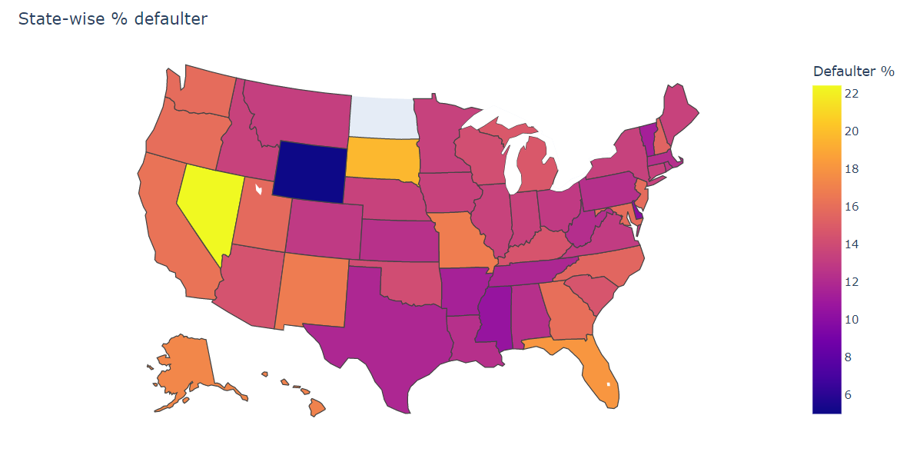
Univariate Analysis
Segmented Univariate Analysis – By geometrics
Wyoming has least number of defaulters
Profiles from western states are slightly more likely to default compared to eastern and central states
5 of the States had less than 10 number of loan
These are replaced with median value of % defaulters

Slide 12
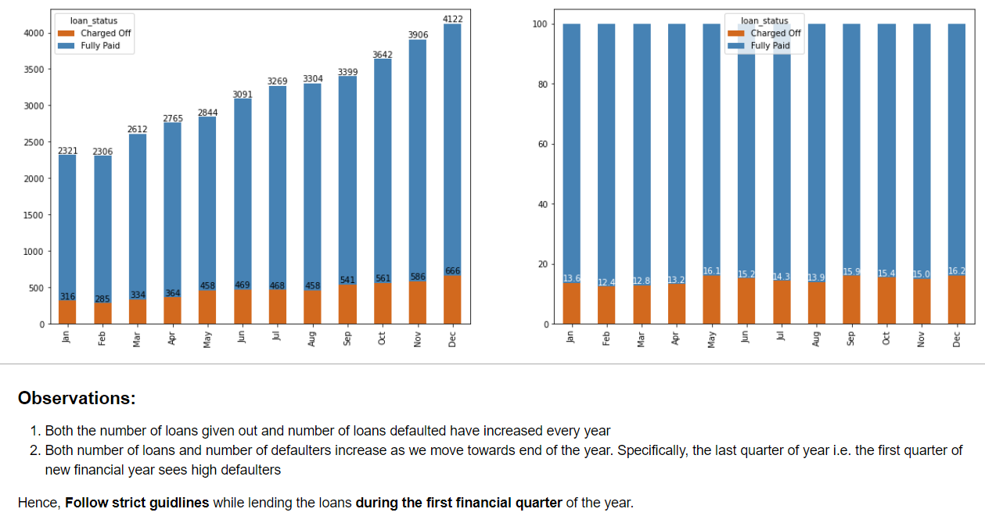
Univariate Analysis
Segmented Univariate Analysis – By Time

Slide 13
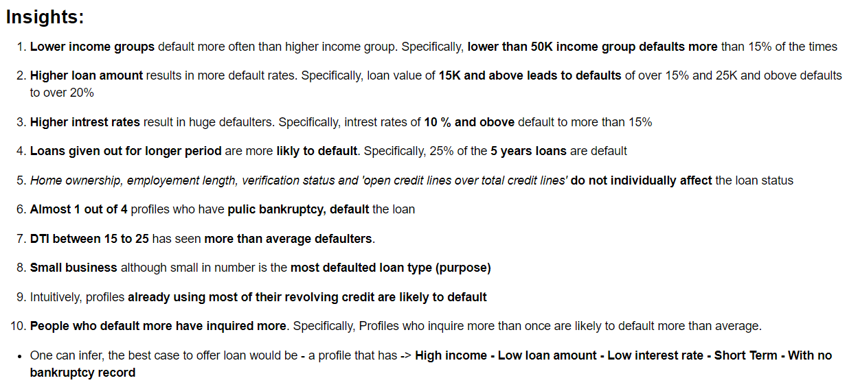
Univariate Analysis
Insights

Slide 14
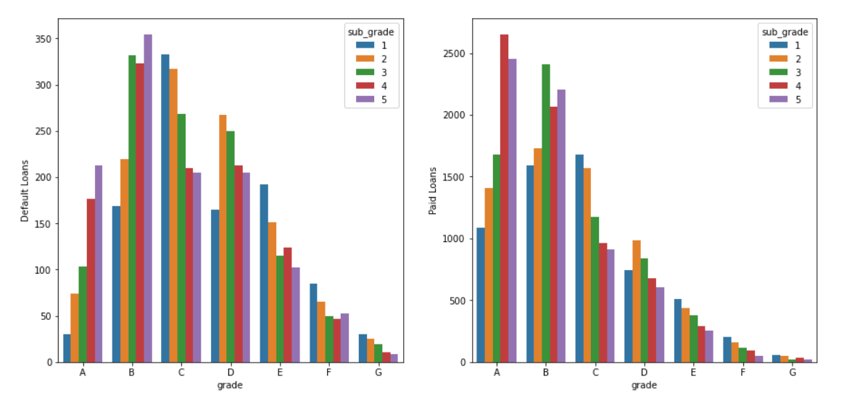
Multivariate Analysis
Grade B loans are defaulted more, while category A loans are paid more often.
Since grade A has very few defaulters and highest payers, Grade category A is the best category to grant loans to.

Slide 15
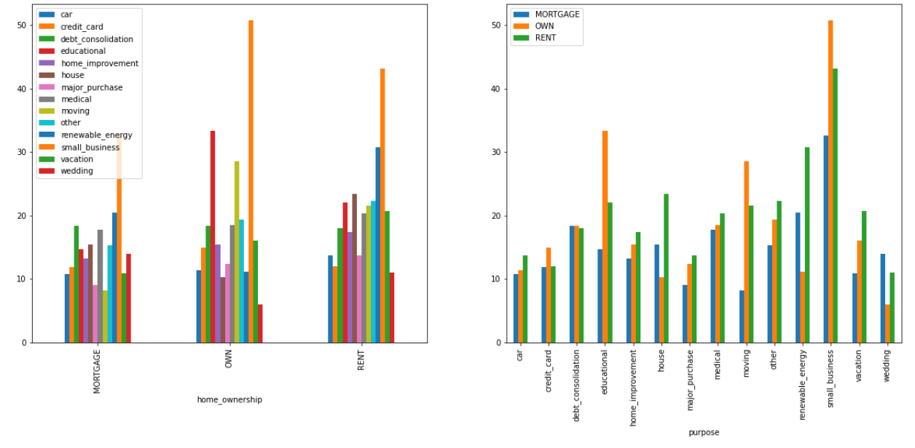
Multivariate Analysis
Purpose of loan – small business in any rental category is worst
While the number of such loans is small yet considerable, these are defaulted the most
People who own house tend to default only slightly more

Slide 16
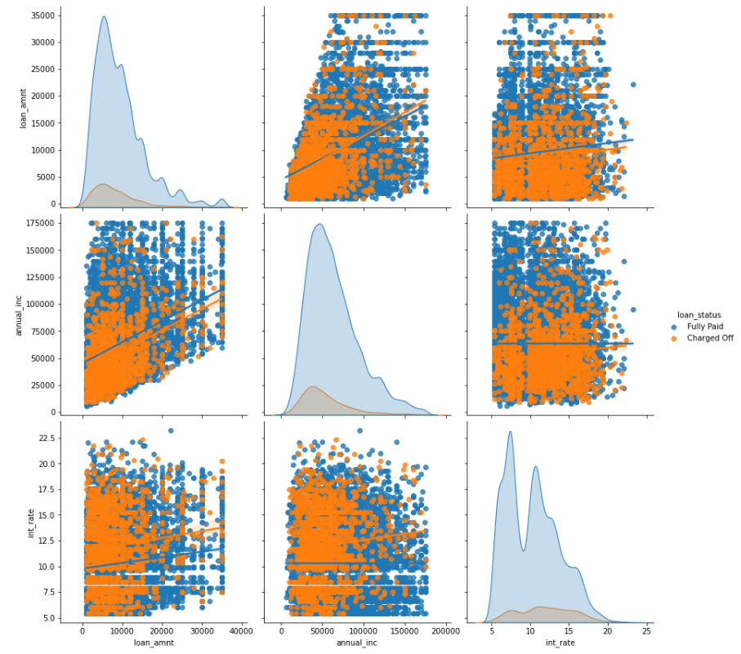
Multivariate Analysis
The important features based on insights are checked for NO significant correlation
Hence these are independent important features
The trends also support the insights generated using Univariate analysis

Slide 17
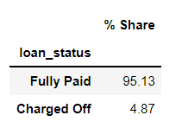
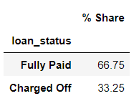
Conclusions and Recommendations
To avoid loss of business:
Lend out loans to candidates who can be categorized into Grade 'A' and its subgrades
Lend out loans to applicants who ->
have High annual income (typically over 50K)
need lesser loan (typically below 15K)
have no previous history of loan defaults OR public bankruptcies
are from eastern or central states
Lend these loans at:
lower intrest rates
for shorter period (36 months)
To avoid financial loss:
Avoid lending out loans to candidates who can be categorized into Grades 'B', 'F' or 'G’ and its subgrades
Avoid lend out loans to applicants who ->
have low annual income (typically less than 50K)
need more loan (typically over 15K)
have previous history of loan defaults OR public bankruptcies
are from western states
need loans for longer period
Perform a better verification : most of the defaulters fall under 'verified' or 'Source Verified' category
Follow strict guidlines while lending the loans during the first financial quarter
Best Case Scenario:
Worst Case Scenario:

